Slide 1
Battery Cooling System
Team:
Swapnil Kedari
Tulsidas Yedle
Manish Yhoudhari
Project Guide:
Professor M j Bhosle

Slide 2
Battery cooling system using BMS and Arduino
Here we are using mainly 4 system for our entire Project
3.7 Volt Li-ion battery (pack of 9 battery)
Motor to pump the coolant in BMS
Battery Management System (BMS) to protect battery
Arduino to automate the whole system

Slide 3
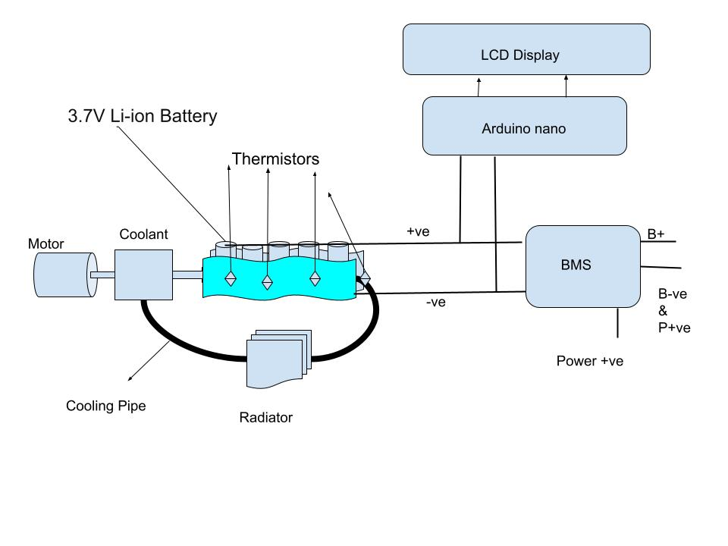
System Diagram

Slide 4
Battery Pack
We are using 3.7 Volts Li-ion rechargeable batteries.
This battery will supply a peak voltage of 32 volts.
This will also supply 5 amp of max current.
We are using BMS to control the peak voltage supply.
These battery will power any device requiring less then 32 volts and 5 amp current.
All the safety features of battery pack is handled by our BMS

Slide 5
Battery Management System (BMS)
Some of the Basic features of our BMS are following:
State of charge calculations.
Cell over-voltage and under-voltage protection.
Intelligent battery balancing (passive).
Battery charger control.
Pack temperature monitoring.
Monitors health of battery pack.

Slide 6
Coolant Pump
Here we are using a coolant pump for heat management.
This will cool our battery from overheating.
This will also maintain ambient temperature for the proper functioning of our battery.
The coolant pump operates automatically using Arduino and temperature sensors.
It turns on if the temperature is above the ambient temperature.
In our case we are considering ambient temperature as 50 degree.

Slide 7
Arduino and Sensors
We are using Arduino nano and thermal sensors.
Thermal sensors will monitor the temperature of our battery pack.
If the sensors sense any surge beyond our ambient temperature then it will signal the Arduino to power on the pump.
If the temperature is under control then the pump will be off.
All of this will pe managed by our Arduino and the program we have written to maintain all of the settings.

Slide 8
This was all about our project for now. As we will progress in our project we will keep you updated with all the changes and update contributed by our team.
Thank You

